Slide 1
Methods
Eric Roberts
CS 106A
January 20, 2010

Slide 2
Once upon a time . . .

Slide 3
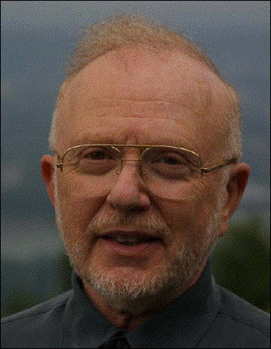
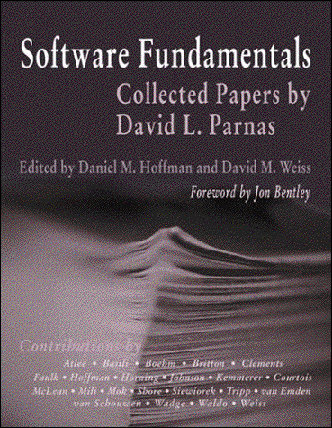
David Parnas
David Parnas is Professor of Computer Science at Limerick University in Ireland, where he directs the Software Quality Research Laboratory, and has also taught at universities in Germany, Canada, and the United States.
Parnas’s most influential contribution to software engineering is his groundbreaking 1972 paper “On the criteria to be used in decomposing systems into modules,” which laid the foundation for modern structured programming. This paper appears in many anthologies and is available on the web at
http://portal.acm.org/citation.cfm?id=361623

Slide 4
Methods

Slide 5
A Quick Overview of Methods
You have been working with methods ever since you wrote your first Java program in Chapter 2. The run method in every program is just one example. Most of the programs you have seen have used other methods as well, such as println and setColor.
At the most basic level, a method is a sequence of statements that has been collected together and given a name. The name makes it possible to execute the statements much more easily; instead of copying out the entire list of statements, you can just provide the method name.
The following terms are useful when learning about methods:
  Invoking a method using its name is known as calling that method.
  The caller can pass information to a method by using arguments.
  When a method completes its operation, it returns to its caller.
  A method can pass information to the caller by returning a result.

Slide 6
Methods and Information Hiding
One of the most important advantages of methods is that they make it possible for callers to ignore the inner workings of complex operations.
When you use a method, it is more important to know what the method does than to understand exactly how it works. The underlying details are of interest only to the programmer who implements a method. Programmers who use a method as a tool can usually ignore the implementation altogether.
The idea that callers should be insulated from the details of method operation is the principle of information hiding, which is one of the cornerstones of software engineering.

Slide 7
Methods as Tools for Programmers
Particularly when you are first learning about programming, it is important to keep in mind that methods are not the same as application programs, even though both provide a service that hides the underlying complexity involved in computation.
The key difference is that an application program provides a service to a user, who is typically not a programmer but rather someone who happens to be sitting in front of the computer. By contrast, a method provides a service to a programmer, who is typically creating some kind of application.
This distinction is particularly important when you are trying to understand how the applications-level concepts of input and output differ from the programmer-level concepts of arguments and results. Methods like readInt and println are used to communicate with the user and play no role in communicating information from one part of a program to another.

Slide 8
Method Calls as Expressions
Syntactically, method calls in Java are part of the expression framework. Methods that return a value can be used as terms in an expression just like variables and constants.
The Math class in the java.lang package defines several methods that are useful in writing mathematical expressions. Suppose, for example, that you need to compute the distance from the origin to the point (x, y), which is given by
x ² + y ²
You can apply the square root function by calling the sqrt method in the Math class like this:
double distance = Math.sqrt(x * x + y * y);
Note that you need to include the name of the class along with the method name. Methods like Math.sqrt that belong to a class are called static methods.

Slide 9
Useful Methods in the Math Class
Math.abs(x)
Returns the absolute value of x
Math.min(x, y)
Returns the smaller of x and y
Math.max(x, y)
Returns the larger of x and y
Math.sqrt(x)
Returns the square root of x
Math.log(x)
Returns the natural logarithm of x (log_{e} x )
Math.exp(x)
Returns the inverse logarithm of x (e ^{x} )
Math.pow(x, y)
Returns the value of x raised to the y power (x ^{y} )
Math.sin(theta)
Returns the sine of theta, measured in radians
Math.cos(theta)
Returns the cosine of theta
Math.tan(theta)
Returns the tangent of theta
Math.asin(x)
Returns the angle whose sine is x
Math.acos(x)
Returns the angle whose cosine is x
Math.atan(x)
Returns the angle whose tangent is x
Math.toRadians(degrees)
Converts an angle from degrees to radians
Math.toDegrees(radians)
Converts an angle from radians to degrees

Slide 10
Method Calls as Messages
In object-oriented languages like Java, the act of calling a method is often described in terms of sending a message to an object. For example, the method call
rect.setColor(Color.RED);
is regarded metaphorically as sending a message to the rect object asking it to change its color.
setColor(Color.RED)
The object to which a message is sent is called the receiver.
The general pattern for sending a message to an object is
receiver.name(arguments);

Slide 11
Writing Your Own Methods
The general form of a method definition is
visibility type name(argument list) {
statements in the method body
}
where visibility indicates who has access to the method, type indicates what type of value the method returns, name is the name of the method, and argument list is a list of declarations for the variables used to hold the values of each argument.
The usual setting for visibility is private, which means that the method is available only within its own class. If other classes need access to it, visibility should be public instead.
If a method does not return a value, type should be void. Such methods are sometimes called procedures.

Slide 12
Returning Values from a Method
You can return a value from a method by including a return statement, which is usually written as
return expression;
where expression is a Java expression that specifies the value you want to return.
As an example, the method definition
private double feetToInches(double feet) {
return 12 * feet;
}
converts an argument indicating a distance in feet to the equivalent number of inches, relying on the fact that there are 12 inches in a foot.

Slide 13
Methods Involving Control Statements
The body of a method can contain statements of any type, including control statements. As an example, the following method uses an if statement to find the larger of two values:
private int max(int x, int y) {
if (x > y) {
return x;
} else {
return y;
}
}
As this example makes clear, return statements can be used at any point in the method and may appear more than once.

Slide 14
The factorial Method
The factorial of a number n (which is usually written as n! in mathematics) is defined to be the product of the integers from 1 up to n. Thus, 5! is equal to 120, which is 1 ^{x} 2 ^{x} 3 ^{x} 4 ^{x} 5.
The following method definition uses a for loop to compute the factorial function:
private int factorial(int n) {
int result = 1;
for (int i = 1; i <= n; i++) {
result *= i;
}
return result;
}

Slide 15
Nonnumeric Methods
Methods in Java can return values of any type. The following method, for example, returns the English name of the day of the week, given a number between 0 (Sunday) and 6 (Saturday):
private String weekdayName(int day) {
switch (day) {
case 0: return "Sunday";
case 1: return "Monday";
case 2: return "Tuesday";
case 3: return "Wednesday";
case 4: return "Thursday";
case 5: return "Friday";
case 6: return "Saturday";
default: return "Illegal weekday";
}
}

Slide 16
Methods Returning Graphical Objects
The text includes examples of methods that return graphical objects. The following method creates a filled circle centered at the point (x, y), with a radius of r pixels, which is filled using the specified color:
private GOval createFilledCircle(double x, double y,
double r, Color color) {
GOval circle = new GOval(x - r, y - r, 2 * r, 2 * r);
circle.setFilled(true);
circle.setColor(color);
return circle;
}
If you are creating a GraphicsProgram that requires many filled circles in different colors, the createFilledCircle method turns out to save a considerable amount of code.

Slide 17
Predicate Methods
Methods that return Boolean values play an important role in programming and are called predicate methods.
As an example, the following method returns true if the first argument is divisible by the second, and false otherwise:
private boolean isDivisibleBy(int x, int y) {
return x % y == 0;
}
Once you have defined a predicate method, you can use it just like any other Boolean value. For example, you can print the integers between 1 and 100 that are divisible by 7 as follows:
for (int i = 1; i <= 100; i++) {
if (isDivisibleBy(i, 7)) {
println(i);
}
}

Slide 18

Using Predicate Methods Effectively
New programmers often seem uncomfortable with Boolean values and end up writing ungainly code. For example, a beginner might write isDivisibleBy like this:
private boolean isDivisibleBy(int x, int y) {
if (x % y == 0) {
return true
} else {
return false;
}
}
While this code is not technically incorrect, it is inelegant enough to deserve the bug symbol.

Slide 19
Using Predicate Methods Effectively
A similar problem occurs when novices explicitly check to see if a predicate method returns true. You should be careful to avoid such redundant tests in your own programs.
for (int i = 1; i <= 100; i++) {
if (isDivisibleBy(i, 7) == true) {
println(i);
}
}

Slide 20
Mechanics of the Method-Calling Process
When you invoke a method, the following actions occur:
1.
Java evaluates the argument expressions in the context of the calling method.
2.
Java then copies each argument value into the corresponding parameter variable, which is allocated in a newly assigned region of memory called a stack frame. This assignment follows the order in which the arguments appear: the first argument is copied into the first parameter variable, and so on.
3.
Java then evaluates the statements in the method body, using the new stack frame to look up the values of local variables.
4.
When Java encounters a return statement, it computes the return value and substitutes that value in place of the call.
5.
Java then discards the stack frame for the called method and returns to the caller, continuing from where it left off.

Slide 21
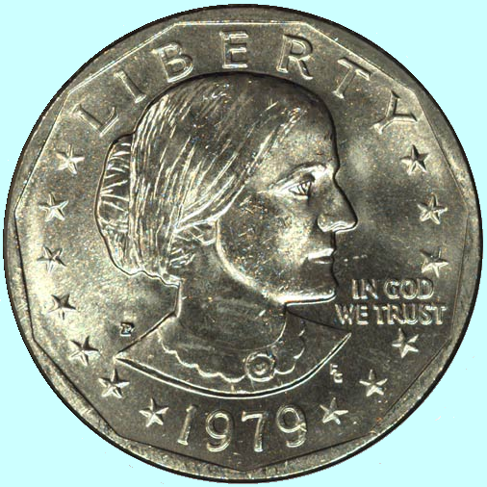
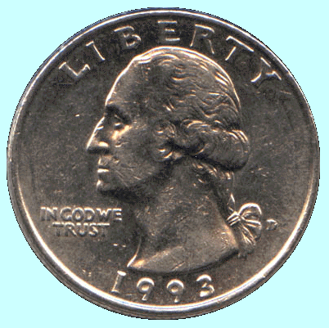
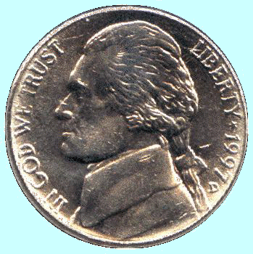
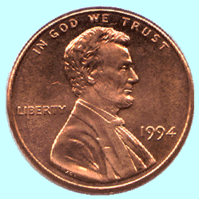
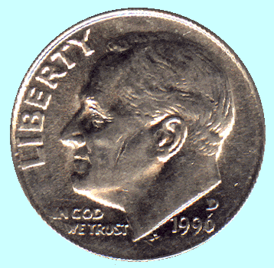
The Combinations Function
To illustrate method calls, the text uses a function C(n, k) that computes the combinations function, which is the number of ways one can select k elements from a set of n objects.
Suppose, for example, that you have a set of five coins: a penny, a nickel, a dime, a quarter, and a dollar:
How many ways are there to select two coins?
penny + nickel
nickel + dime
dime + quarter
quarter + dollar
penny + dime
nickel + quarter
dime + dollar
penny + quarter
nickel + dollar
penny + dollar
for a total of 10 ways.

Slide 22
Combinations and Factorials
Fortunately, mathematics provides an easier way to compute the combinations function than by counting all the ways. The value of the combinations function is given by the formula
n !
C(n, k) =
k !
x
(n – k) !
Given that you already have a factorial method, is easy to turn this formula directly into a Java method, as follows:
private int combinations(int n, int k) {
return factorial(n) / (factorial(k) * factorial(n - k));
}
The next slide simulates the operation of combinations and factorial in the context of a simple run method.

Slide 23
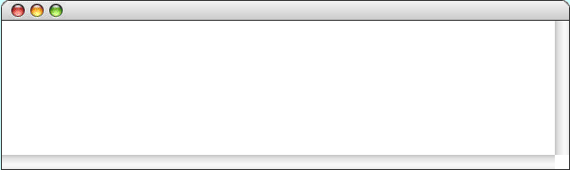
The Combinations Program
public void run() {
int n = readInt("Enter number of objects in the set (n): ");
int k = readInt("Enter number to be chosen (k): ");
println("C(" + n + ", " + k + ") = " + combinations(n, k) );
}
public void run() {
int n = readInt("Enter number of objects in the set (n): ");
int k = readInt("Enter number to be chosen (k): ");
println("C(" + n + ", " + k + ") = " + combinations(n, k) );
}
private int combinations(int n, int k) {
return factorial(n) / ( factorial(k) * factorial(n - k) );
}
private int factorial(int n) {
int result = 1;
for ( int i = 1 ; i <= n ; i++ ) {
result *= i;
}
return result;
}
private int factorial(int n) {
int result = 1;
for ( int i = 1 ; i <= n ; i++ ) {
result *= i;
}
return result;
}
private int factorial(int n) {
int result = 1;
for ( int i = 1 ; i <= n ; i++ ) {
result *= i;
}
return result;
}
120
2
6
10
n
k
n
k
n
k
5
2
5
2
n
5
2
n
n
result
result
result
i
i
i
5
2
3
120
24
6
6
2
2
2
1
1
1
5
4
4
3
3
3
2
2
2
1
1
1
6
At this point, the program calls the combinations method, as follows:
The program now calls the factorial method, applying the same process.
The program makes another call to factorial, with k as its argument.
The program calls factorial yet again with n - k as its argument.
1. Evaluate the arguments n and k to get the integers 5 and 2.
The factorial method returns the value 120 to its caller.
This call to factorial returns the value 2.
The final call to factorial returns the value 6.
2. Create a new frame for the combinations method.
3. Initialize the parameter variables n and k to the argument values.
Combinations
Enter number of objects in the set (n):
5
Enter number to be chosen (k):
2
C(5, 2) = 10
skip simulation

Slide 24
Exercise: Finding Perfect Numbers
Greek mathematicians took a special interest in numbers that are equal to the sum of their proper divisors (a proper divisor of n is any divisor less than n itself). They called such numbers perfect numbers. For example, 6 is a perfect number because it is the sum of 1, 2, and 3, which are the integers less than 6 that divide evenly into 6. Similarly, 28 is a perfect number because it is the sum of 1, 2, 4, 7, and 14.
For the rest of this class, we’re going to design and implement a Java program that finds all the perfect numbers between two limits. For example, if the limits are 1 and 10000, the output should look like this:
FindPerfect
The perfect numbers between 1 and 10000 are:
6
28
496
8128

Slide 25
The End

